Slide 1


Faculty of Computing and Informatics
Week 2
Databases and Database users

Slide 2
Objectives
By the end of this lesson, students should be able to:
Describe the history of Database
Identify the characteristics of the database approach
Explain the advantages of the Database Management system approach.
State examples of databases and their users.

Slide 3
Introduction
Let’s discuss these questions.
How are records stored in organisations ?
How easy is it to access and update the records?
Are there ways in which the current processes can be improved?

Slide 4
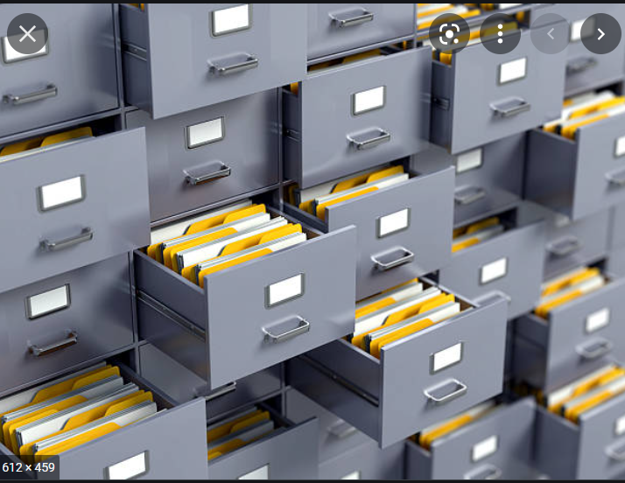

Filing system

Slide 5
History of databases
One way to keep information on a computer is to store it in permanent files.
A company system has a number of application programs; each of them is designed to manipulate data files.
New applications are added to the system as the need arises.
The system just described is called the file-based system.

Slide 6
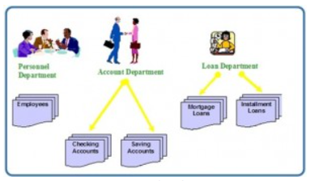
File based system
Consider a traditional banking system that uses the file-based system to manage the organization’s data shown below.
Bank has different departments with each having its own applications that manage and manipulate different data files.

Slide 7
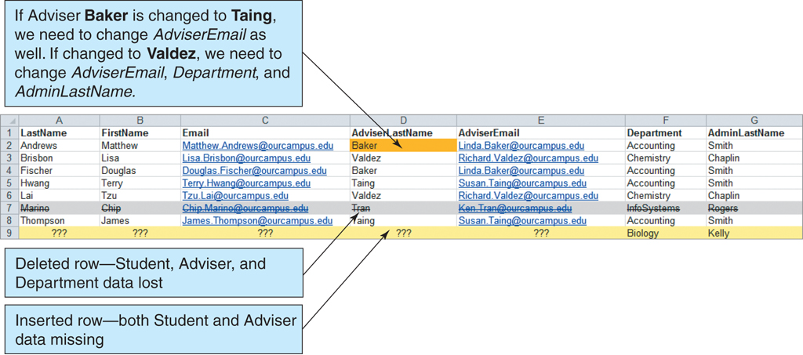
History of Databases
Consider information that is kept in a list
Kroenke & Auer (2013)

Slide 8
History of Database
In a list /file :
1. Each row is intended to stand on its own. As a result, the same information may be entered several times.
2. Each row may contain information on more than one theme.
Raises modification problems
Relational databases designed to address the complexities
The purpose of a database is to keep track of things.

Slide 9
History of Database
Databases introduced to deal with the file/list approach
allows the management of large amounts of organizational information
A database is a shared collection of related data used to support the activities of a particular organization.
Several types of databases e.g. relational database which stores information in tables.
Each informational topic is stored in its own table.

Slide 10
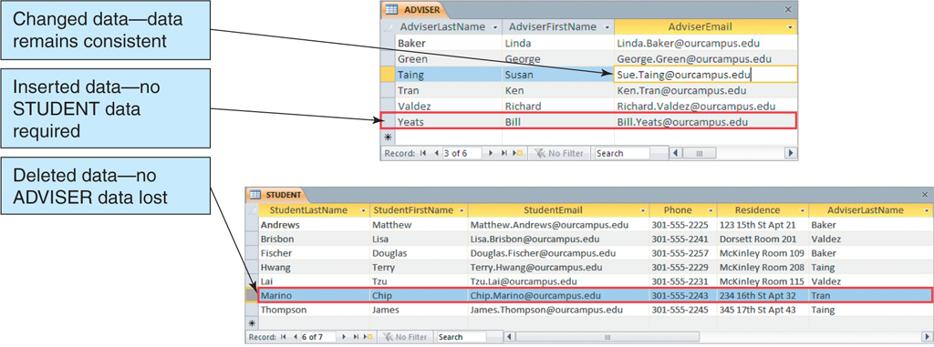
History of Databases

Slide 11
File Approach- problems
Uncontrolled redundancy
Inconsistent data
Inflexibility
Limited data sharing
Poor enforcement of standards
Low programmer productivity
Excessive program and data maintenance

Slide 12
Characteristics of Database Approach
Comment on the way data is stored nowadays with regards to
Ease of access to information/ records
Updating the information
The details available about the stored information
Ability to share the information
Security
Integrity

Slide 13
Characteristics of Database Approach
Structured and Described Data- self-describing because it contains the database itself as well as the metadata which defines and describes the data and relationships between tables in the database.
Separation of Data and Applications - Application software only communicates with the management system of a database (DBMS) via a standardized interface with the help of a standardized language like SQL. This insulation between the programs and data is also called program-data independence.

Slide 14
Characteristics of Database Approach
Data Integrity- the protection of the database from unauthorized access and unauthorized changes. Data reflect facts of the real world.
Sharing of data and multiuser system- they allow many users to access the same database at the same time
Support for multiple views of data- Multiple users in the system might have different views of the system
Control of data redundancy - each data item is stored in only one place in the database.
Backup and recovery- The database system provides a separate process, from that of a network backup, for backing up and recovering data.

Slide 15
Database Management System (DBMS)
A Database Management System (DBMS) is:​
A software system designed to store, manage, and facilitate access to databases.​
is a collection of programs that enables users to create and maintain databases and control all access to them.
The primary goal of a DBMS is to provide an environment that is both convenient and efficient for users to retrieve and store information.

Slide 16
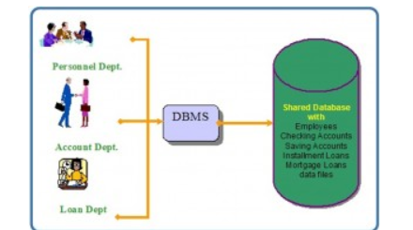
Database Management System (DBMS)
we can have the traditional banking system as shown in the Figure
A DBMS is used by the Personnel Department, the Account Department and the Loan Department to access the shared corporate database.

Slide 17
Database Management System (DBMS)
Following the definition of a DBMS we have discussed, give examples of DBMSs

Slide 18
Database Approach
Controlled redundancy – consistency of data & integrity constraints
• Integration of data – self-contained – represents semantics of application
• Data and operation sharing – multiple interfaces
• Services & controls – security & privacy controls – backup & recovery – enforcement of standards
• Flexibility – data independence – data accessibility – reduced program maintenance
• Ease of application development

Slide 19
Database Users
Database users are the one who really use and take the benefits of database.
There will be different types of users depending on their need and way of accessing the database.

Slide 20
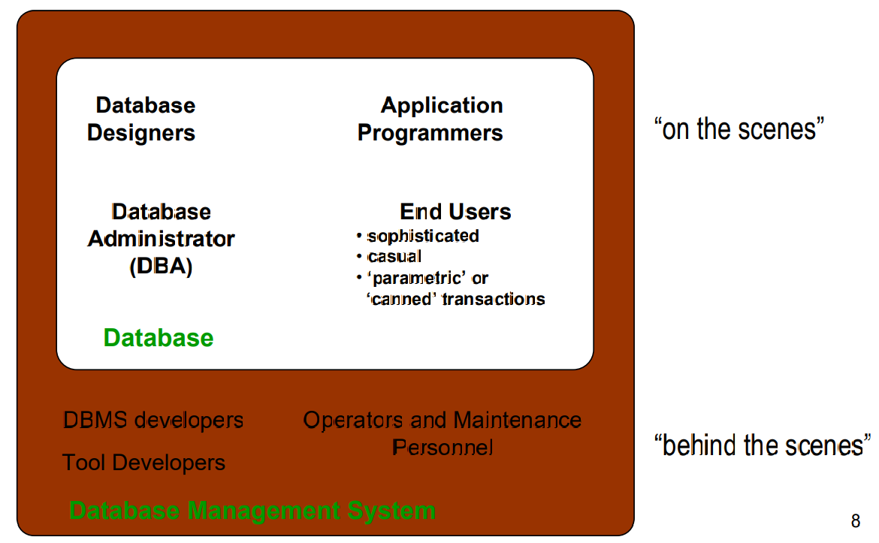
Database Users
Application programmers- They are the developers who interact with the database by means of queries written in programming languages like C, C++, Java. These users implement specific application programs to acces the stored data.
Database Administrators - This may be one person or a group of people in an organization responsible for authorizing access to the database, monitoring its use and managing all of the resources to support the use of the entire database system
End users - these are the users who use the existing application to interact with the database. They require access to a database for querying, updating and generating reports.
Database developers - write SQL queries to select/insert/delete/update data. They do not use any application or programs to request the database. They directly interact with the database by means of query language like SQL.

Slide 21
Database Users
Database developers - write SQL queries to select/insert/delete/update data. They do not use any application or programs to request the database. They directly interact with the database by means of query language like SQL.
Find the roles of these users
1. Database designers
2. Tool developers
3. Operators and maintenance personnel

Slide 22
An example database
Microsoft Office Access database templates
Access students database
Explore the database

Slide 23
Summary
In this lecture, we discussed
The history of Database
Characteristics of the database approach
Advantages of the Database Management system approach.
Examples of databases and their users.

Slide 24
Next lecture
We will discuss the following database concepts in our next theory lesson:
Types of database systems
Client-server architecture
Database system concepts
Data models
NB: Do not forget to attend your practical class / lab

Slide 25
References
Werner, Nutt (n.d.) Introduction to Database Systems Motivation.
Kroenke, David M. And Auer, David J. (2013). Database Concepts, 6th Edition Pearson Education, Inc. Publishing as Prentice Hall

